Slide 1
Cortex-M4 System Timer
HCM - 2021

Slide 2
Agenda
Overview
Hardware diagram
Registers
Example code

Slide 3
Overview
Generate SysTick interrupts at a fixed time interval
Example Usages:
Measuring time elapsed, such as time delay function
Executing tasks periodically, such as periodic polling, and OS CPU scheduling
SysTick interrupts
time
Fixed time interval

Slide 4
System Timer (SysTick)
System timer is a standard hardware component built into ARM Cortex-M.
This hardware periodically forces the processor to execute the following ISR:
Peripherals
IRQs
NVIC
Processor
Core
I/O pins
IRQs
System
Exceptions
void SysTick_Handler(void){
...
}
SysTick IRQ
System Timer
ARM Cortex-M
Microcontroller

Slide 5
Diagram of System Timer (SysTick)
Reload Value
copy
Yes
Counter
Is it zero?
24-bit down counter

Slide 6
System Timer Operation
SysTick Interrupt
SysTick Interrupt
SysTick Interrupt

Slide 7
Diagram of System Timer (SysTick)
Reload Value
copy
Yes
Counter
Is it zero?
Set COUNTFLAG to 1
24-bit down counter
SysTick control and status register (SysTick_CTRL)

Slide 8
Diagram of System Timer (SysTick)
Reload Value
External clock
copy
AHB Clock
/8
0
Yes
Counter
Is it zero?
Set COUNTFLAG to 1
1
AND
Processor clock
24-bit down counter
SysTick control and status register (SysTick_CTRL)

Slide 9
Registers of System Timer
SysTick control and status register (SysTick_CTRL)
SysTick reload value register (SysTick_LOAD)
SysTick calibration register (SysTick_CALIB)
SysTick current value register (SysTick_VAL)

Slide 10
Registers of System Timer
SysTick reload value register (SysTick_LOAD)
24 bits, maximum value 0x00FF.FFFF (16,777,215)
Counter counts down from RELOAD value to 0.
Writing RELOAD to 0 disables SysTick, independently of TICKINT
Time interval between two SysTick interrupts
If 100 clock periods between two SysTick interrupts
Interval = (RELOAD + 1) × Source_Clock_Period
RELOAD = 99

Slide 11
Registers of System Timer
SysTick current value register (SysTick_VAL)
Reading it returns the current value of the counter
When it transits from 1 to 0, it generates an interrupt
Writing to SysTick_VAL clears the counter and COUNTFLAG to zero
Cause the counter to reload on the next timer clock
But, does not trigger an SysTick interrupt
It has random value on reset.
Always clear it before enabling the timer

Slide 12
Registers of System Timer
SysTick calibration register (SysTick_CALIB)
A read-only register
TENMS (10 ms) holds the reload value, which will yield a 10ms period
May not be implemented or may be defined differently by chip designers

Slide 13
Example Code
void SysTick_Initialize (uint32_t ticks) {
SysTick->CTRL = 0; // Disable SysTick
SysTick->LOAD = ticks - 1; // Set reload register
// Set interrupt priority of SysTick to least urgency (i.e., largest priority value)
NVIC_SetPriority (SysTick_IRQn, (1<<__NVIC_PRIO_BITS) - 1);
SysTick->VAL = 0; // Reset the SysTick counter value
// Select processor clock: 1 = processor clock; 0 = external clock
SysTick->CTRL |= SysTick_CTRL_CLKSOURCE;
// Enables SysTick interrupt, 1 = Enable, 0 = Disable
SysTick->CTRL |= SysTick_CTRL_TICKINT;
// Enable SysTick
SysTick->CTRL |= SysTick_CTRL_ENABLE;
}

Slide 14
Implementing Delay Function
volatile int32_t TimeDelay;
int main (void {
SysTick_Initialize(1000); // Interrupt period = 1000 cycles (us) = 1ms
Delay(100); // Delay 100 ticks
...
}
void SysTick_Handler (void) { // SysTick interrupt service routine
if (TimeDelay > 0) // Prevent it from being negative
TimeDelay--; // TimeDelay is a global volatile variable
}
void Delay (uint32_t nTime) {
// nTime: specifies the delay time length
TimeDelay = nTime; // TimeDelay must be declared as volatile
while(TimeDelay != 0); // Busy wait
}

Slide 15
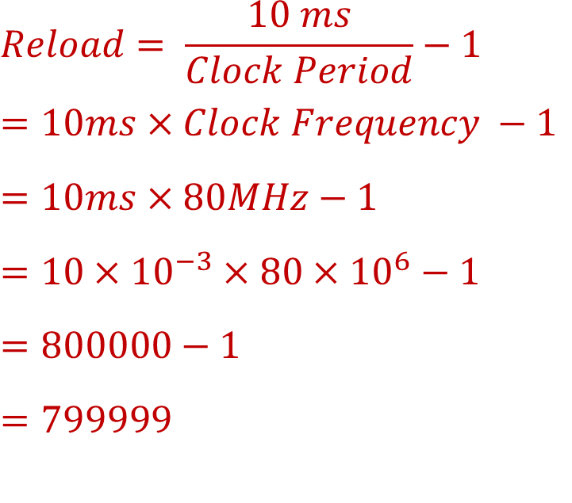
Calculating Reload Value
Suppose clock source = 80MHz
Goal: SysTick Interval = 10ms
What is RELOAD value?
$$Reload= \frac{10 ms}{Clock Period}−1$$
$$=10ms×Clock Frequency −1$$
$$=10ms×80MHz−1$$
$$=10×{10}^{−3}×80×{10}^{6}−1$$
$$=800000−1$$
$$=799999$$

Slide 16
Question ?

